Slide 1

Major Project -1(CA301P) Odd Semester Session 2025-26 “Smart Erase” Ayush Saini (202410116100046) Ashish Yadav (202410116100041) Ashutosh Singh (202410116100043) Session:2025-2026 (III Semester) Under the supervision of Mr. Roshan Kumar Gupta Department Of Computer Applications KIET GROUP OF INSTITUTIONS, DELHI-NCR, GHAZIABAD-201206

Slide 2

Major Project
AI-Based Image Background Removal

Slide 3
Introduction
Background removal means separating the subject from the background in an image.
Traditionally done using tools like Photoshop, which takes skill and time.
AI makes this process automatic, faster, and more accurate.
Useful for handling even complex images like hair, edges, or transparent objects.

Slide 4
Problem Statement
Manual editing is time-consuming and not practical for bulk images.
Requires expert knowledge of editing tools.
Often leads to errors around edges or incomplete separation.
A solution is needed that works quickly, accurately, and without much effort.

Slide 5
Objective
1
Build a system that can automatically remove backgrounds from images.
2
Clearly detect the subject and separate it from the background.
3
Provide the result as a transparent or customized background.
4
Make background removal easy for everyone, even non-designers.

Slide 6

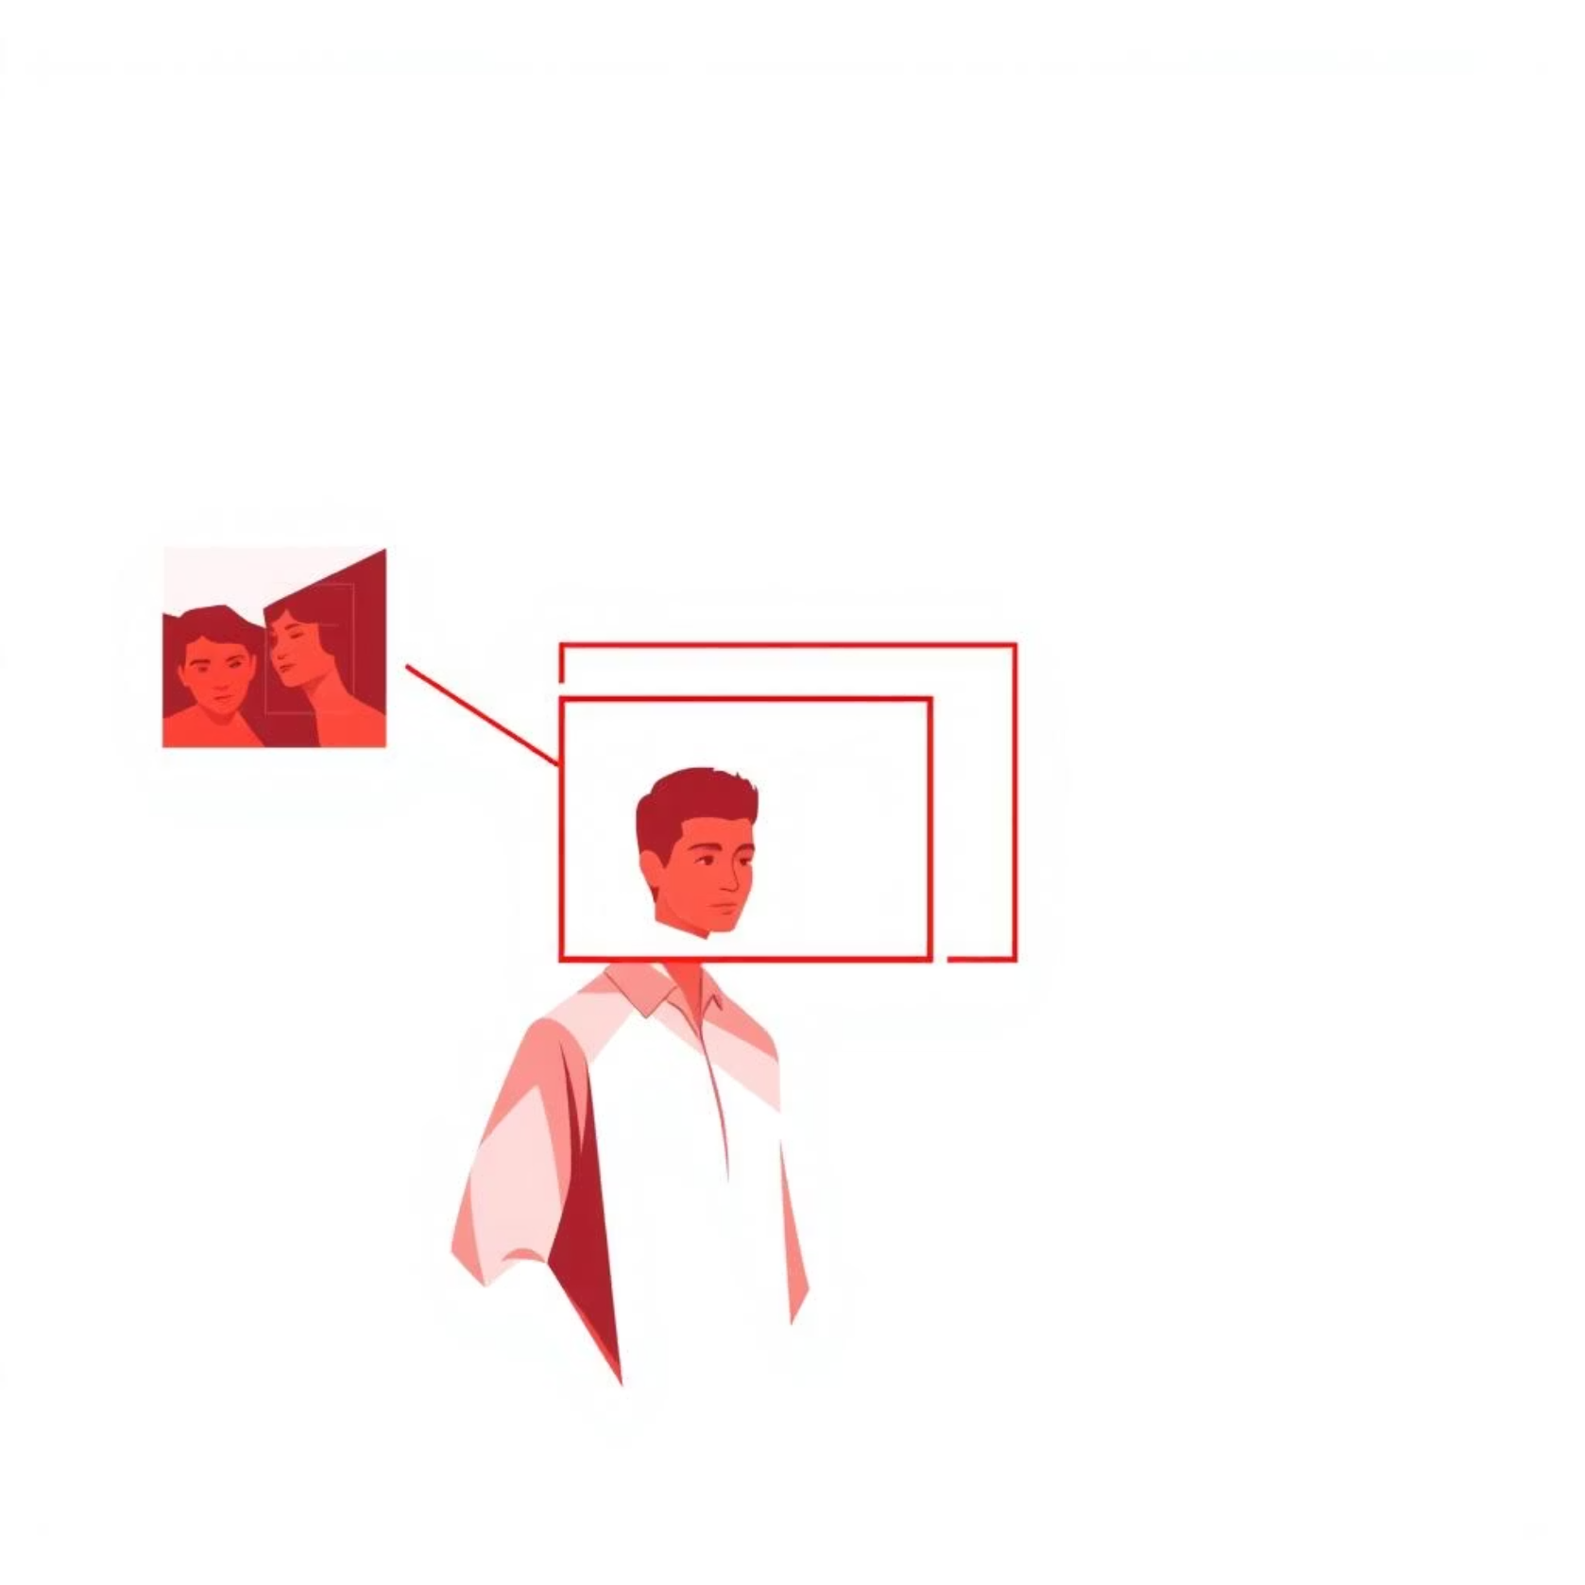

How It Works (AI Approach)
User gives an input image.
AI model analyzes and detects subject vs background.
Uses deep learning methods like image segmentation.
Removes the background and provides a clean cut-out subject.

Slide 7

Tools & Technologies
Programming Language: Python
Pre-trained Models: U²-Net, DeepLab, Mask R-CNN
Libraries: TensorFlow, PyTorch, OpenCV
Deployment: Web application or desktop tool for users

Slide 8





Applications
E-commerce: Clean product images for websites.
Photography: Quick editing of portraits and event photos.
Social Media: Easy background changes for posts.
Graphic Design: Posters, banners, and marketing materials.
Video Editing: Alternative to green screen for creators.

Slide 9





Advantages of AI Background Removal
Faster than manual methods.
Accurate results, even for hair and complex edges.
Cost-effective: No need for paid editing tools.
Scalable: Works well for multiple images at once.
User-friendly: Can be used by non-technical people.

Slide 10
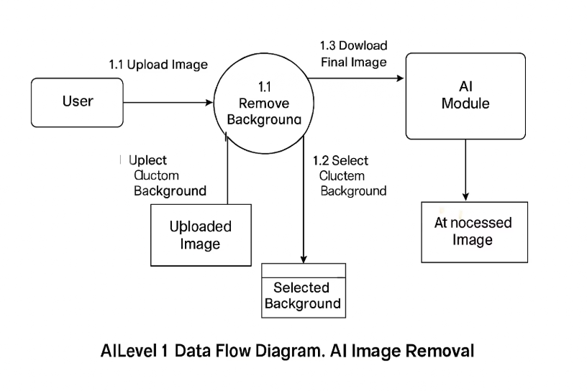
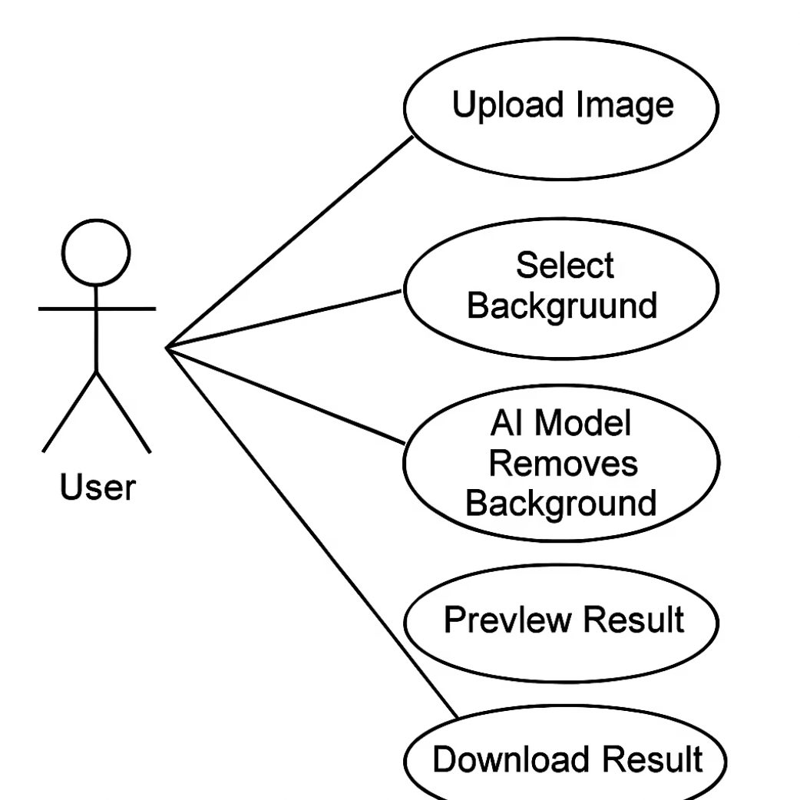
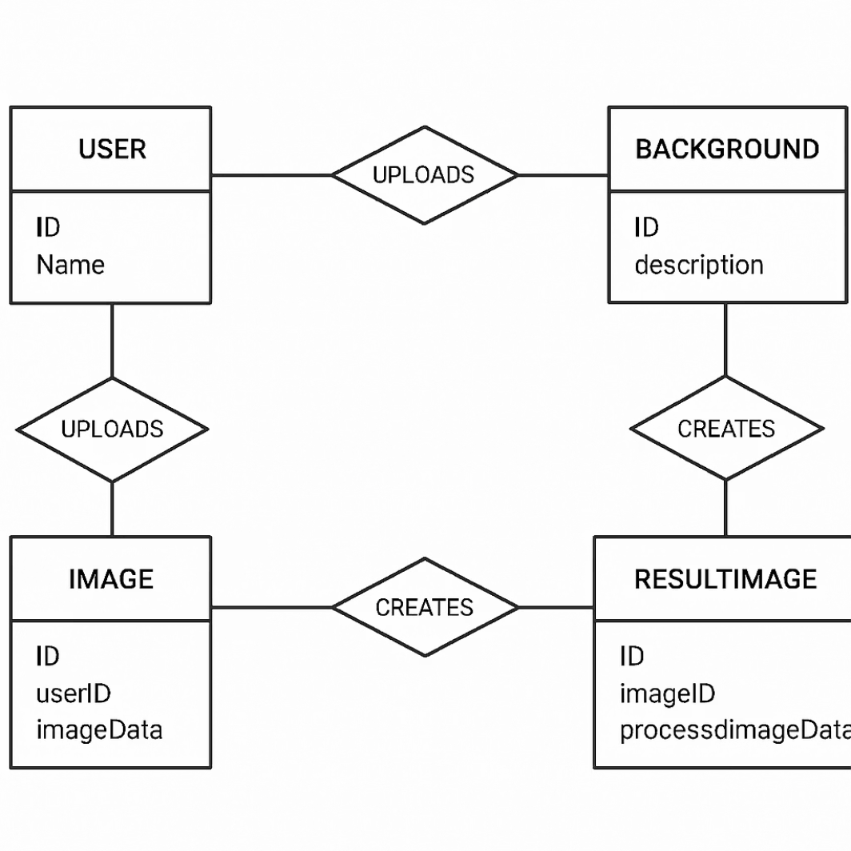
Use Case Diagram
ER Diagram
Data Flow Diagram
This diagram shows the actions of the user in the system.
This diagram explains the database design of the system.
This diagram shows how data moves in the system.
The user uploads an image, which goes to the background removal process.
The user can upload an image and select a background.
Each image is connected with the user ID and stored in the database.
The AI model processes the image and removes the background.
The AI model automatically removes the background.
The AI creates a result image, which is linked to the original uploaded image.This diagram shows how data moves in the system.
It explains the step-by-step flow from input to output.
The user can preview the result before downloading.
The user uploads an image, which goes to the background removal process.
It explains the step-by-step flow from input to output.

Slide 11

Conclusion & Future Scope
AI background removal makes editing simple, fast, and professional.
Saves time and effort compared to manual editing.
Future Scope:
Real-time video background removal
Mobile app integration
Smart background customization (blur, replace, stylize)

